Slide 1

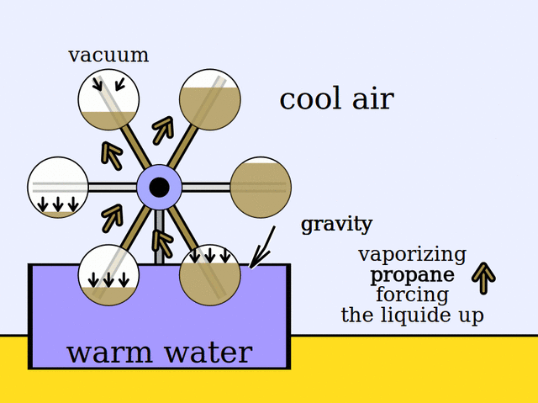
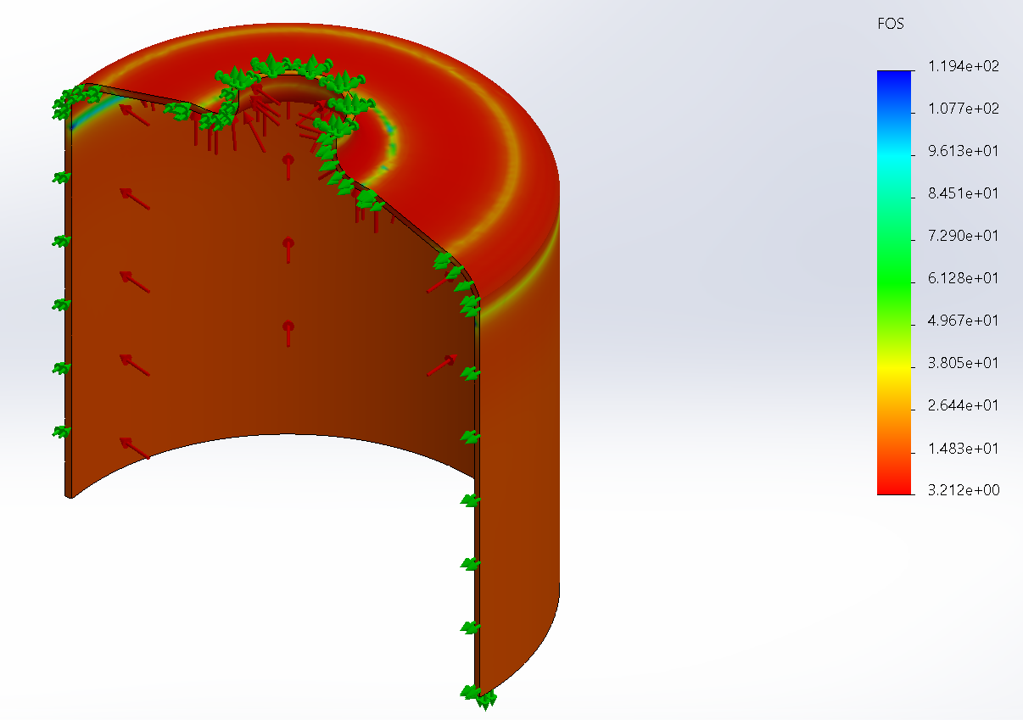
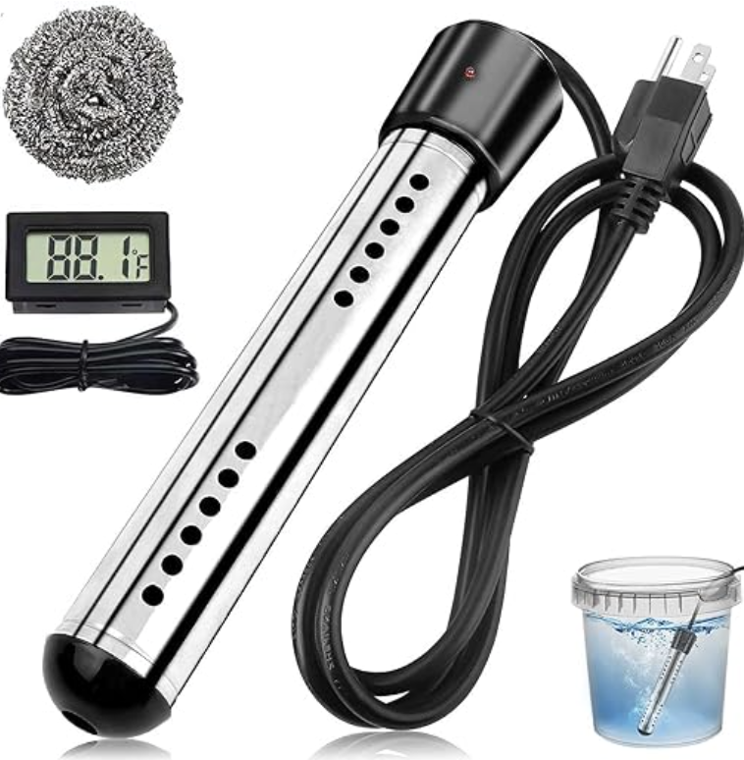
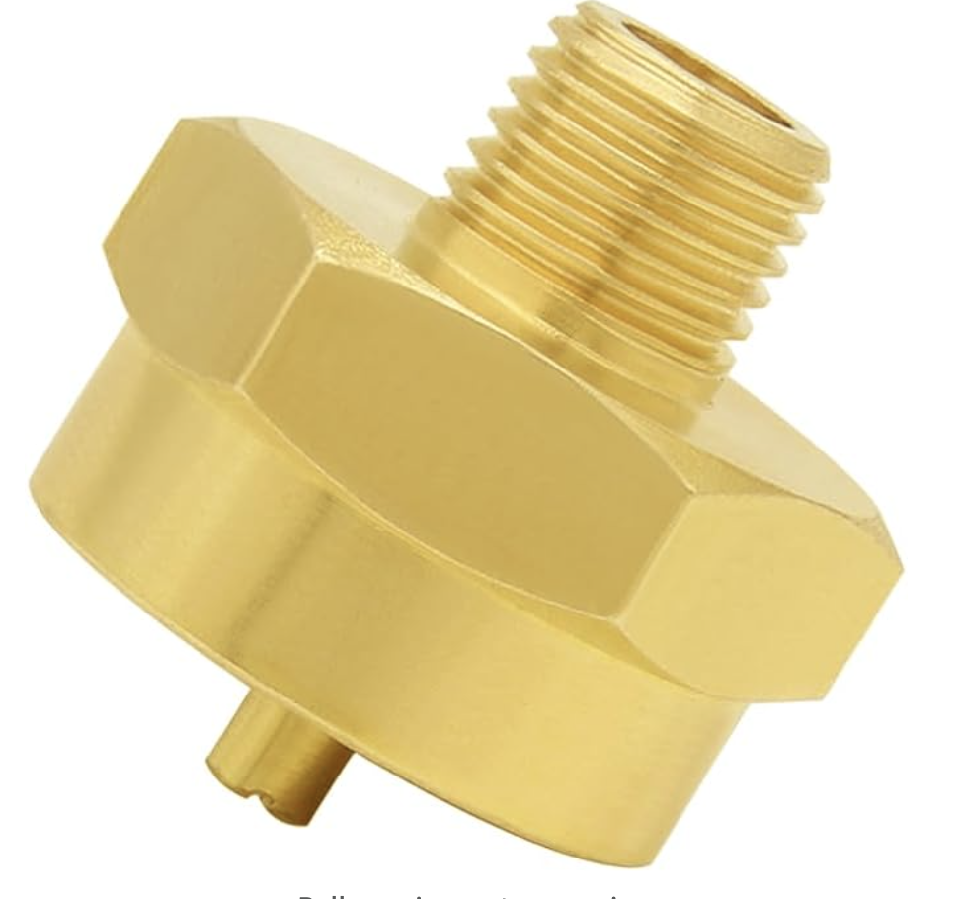
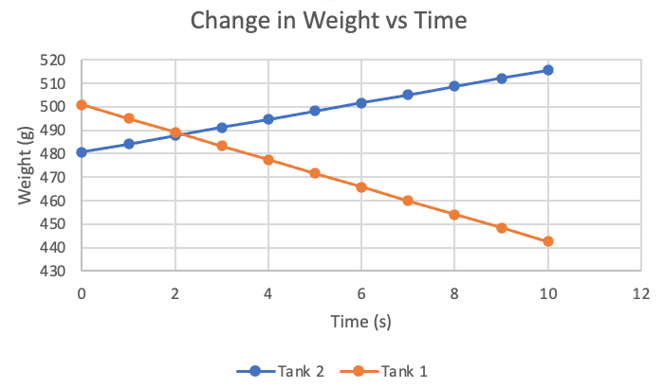
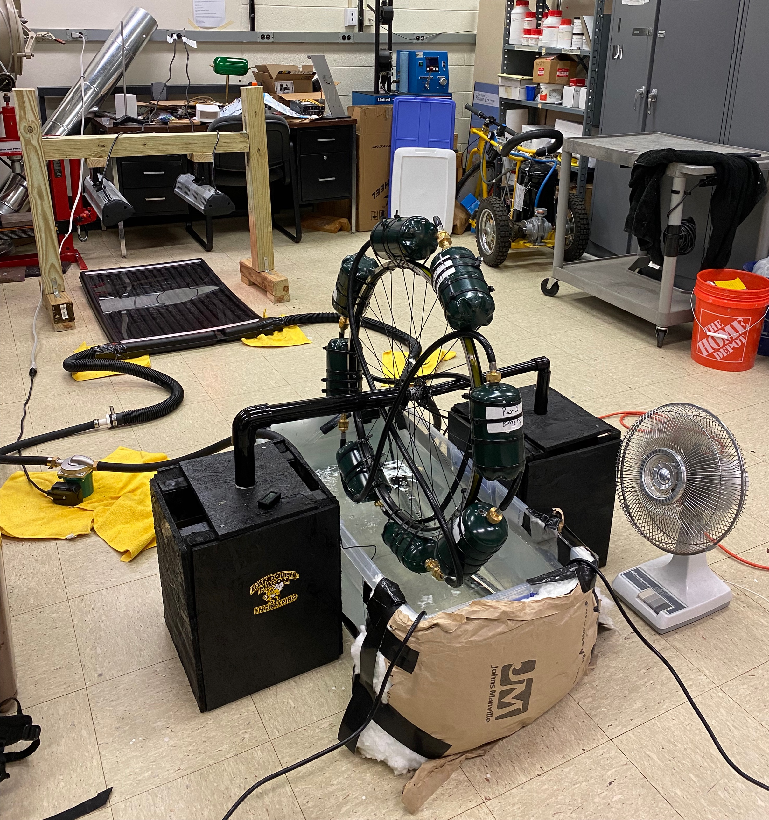
Solar Powered Minto Wheel
Nate DeLong, Megan Bost, Davis Clemmons, Grayson Bush
Randolph-Macon College Department of Physics, Engineering, and Astrophysics
Objective
Experiments
Results
Create a Minto wheel constructed out of low-cost materials that uses solar power to heat gas tanks and generate torque.
How does it work?
Experiment 1
Ran a SolidWorks FEA simulation to test propane tank capabilities under heated conditions, (Figure 3).
Per ASME Section VIII code, a Factor of Safety of 3 is required for use of a pressure vessel of this kind.
The FOS , yield strength, and max stress was calculated using a max pressure of 200 psi, (Table 1).
Experiment 2
Gas transfer experiment conducted to determine amount and rate of gas transfer between tanks at given temperature.
Data shows the results for the experiment at 120°F which was needed to produce significant transfer of gas, (Figure 4).
Starting weights differ because the adapters on one tank were heavier than the other.
Propane causes the wheel to spin at a water temperature of 120°F and angular velocity increases as the water temperature increases.
Max temperature tested was 160°F and max angular velocity was 0.5 rev/min.
Results show a wheel efficiency of less than 1%.
Need a liquid with a lower boiling point and a resistant force to increase efficiency.
Table 1: Data calculating during the FEA simulation of the propane tanks.
Challenges
Yield strength | Max Stress | Factor of Safety
90 ksi | 28 ksi | 3.21
Different adapters had to be connected together to fasten propane tanks to one another and leaks were contained using Teflon pipe tape on connections.
Additional submersible heaters were required to
reach necessary temperature for the wheel to spin.
Rotation was not uniform because wheel speed does not allow the tanks following in rotation to heat up.
Figure 1: The science behind the wheel.
Motivation
Problems like global warming and climate change present an ever-growing need for clean energy.
Construct the wheel out of easily accessible and affordable materials.
Prototype Model Development
Figure 3: SolidWorks FEA simulation for sample propane tank.
Propane chosen for its low boiling point, affordability, and availability.
Propane tanks connected using hoses and adaptors.
Bike wheel with a rachet used as the wheel frame with propane pairs fastened.
Wooden bases and PVC hold assembly in place over the plastic hot water reservoir.
Hot water bath was filled, and a pump circulates water through solar collector heated by lamps.
Figure 5: Immersion Heater.
Figure 6: Male to Female Throwaway Cylinder Connector.
Conclusion
Propane is an effective medium for operating this Minto wheel from solar power and is cost effective and an easily accessible material.
This wheel will run indefinitely with this system.
Future Research
Find the exact temperature and resistance needed to make wheel revolutions uniform and constant.
Try to generate power using the wheel's torque.
Acknowledgements
Randolph-Macon College Department of Physics, Engineering, and Astrophysics
Professor James T. McLeskey, Jr.
Professor Zachary E. Cullingsworth
Figure 2: Final Minto Wheel Assembly.
Figure 4: Graph depicting the gas transfer experiment once the propane tanks were connected to one another.

